Slide 1
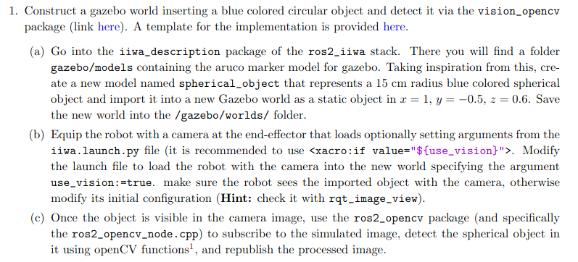
Homework 3
This homework consist in using again the iiwa manipulator but in this case we’re supposed to use some more advanced vision tasks, a part from just mounting a camera on the robot. The first point of this HW is showed below and in the next slides I’ll discuss about it and show the results I’ve obtained:

Slide 2
Homework 3
So, firstly we have to create a new model of a blue spherical object, more in detail a static one so it not would fall and then we have to import it our gazebo environment. Then we have to mount a camera on the robot but only if the parameter “use_vision” is set to true and we need to test this. For last we need to use and modify appropriately the openCV node, so that this software can see what the camera sees and its task is to identify the blue sphere in our world. So in the next slides I’ll show what I’ve done to implement this and also all the tests to prove it.

Slide 3
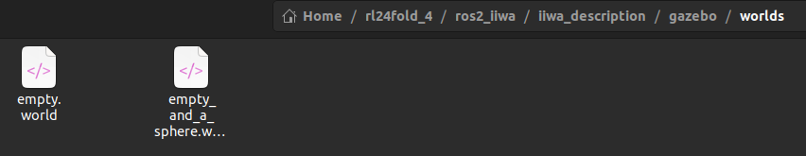
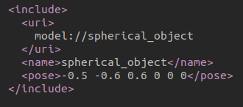
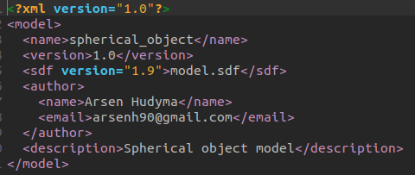
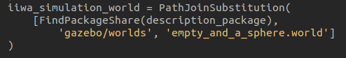
Homework 3
Here there are pretty much photos but lets proceed in order. One of the first things that I did was to create a new world file with a name that is autoexplicative. In this world I included the model of the sphere, specifing the path to it and the folder name. In this folder there is a config file which is used to give a description to the model and also other informations such as the authot of it. More importantly, there’s specified the sdf file from which we can retrieve the effective model (showed in the next slide). The last photo in the lower right side is some code of the launch file, so that we can decide in which world the robot has to spawn.

Slide 4
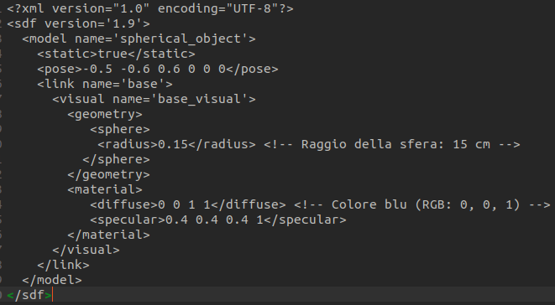
Homework 3
Like said before, here there’s the sdf file of the sphere, the configuration static = true is important, otherwise the sphere would fall due to gravity:

Slide 5
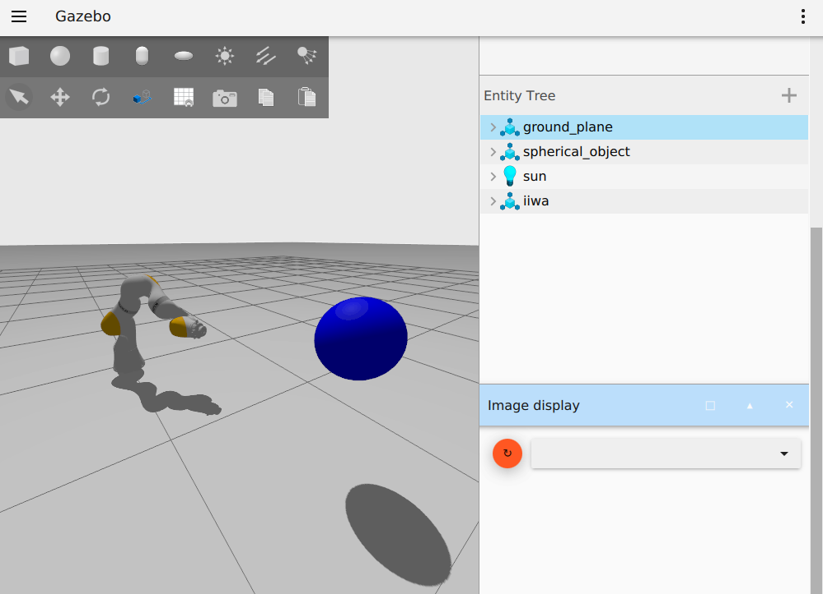
Homework 3
Here we can see that the blue sphere is present in our world and also another thing that we can notice is that the camera isn’t mounted, in fact we don’t see anything in the image_display and there are no topics, that’s because the use_vision parameter is set to false by default:

Slide 6
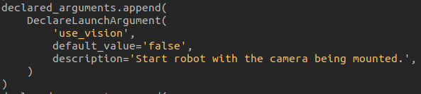
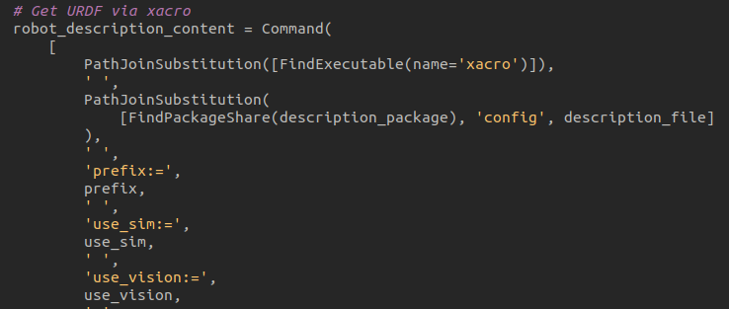
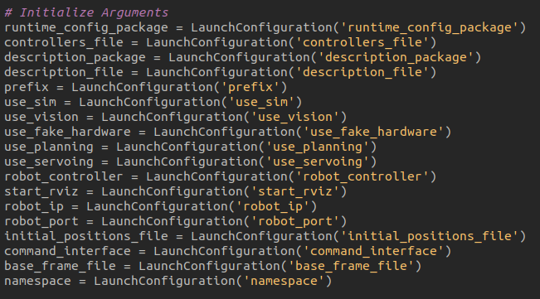
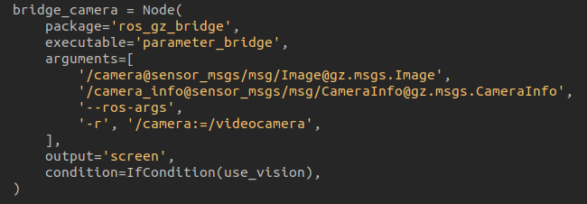
Homework 3

Slide 7
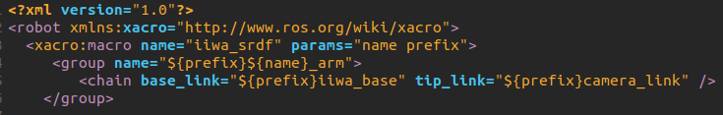
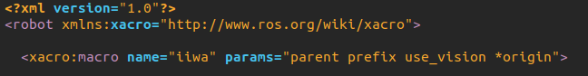
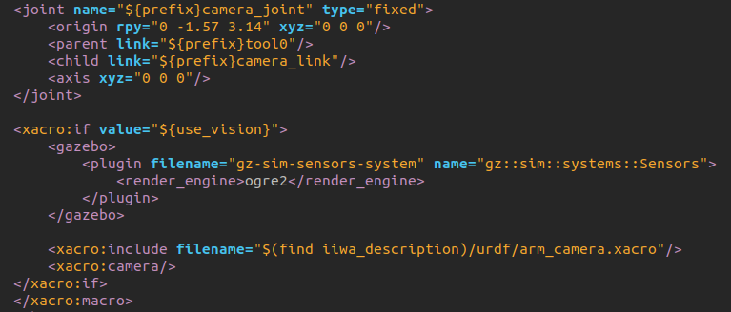
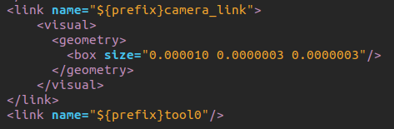
Homework 3
Here instead it’s shown how the camera is implemented in the description file of the robot, we can notice that also in this code we use the “use_vision” parameter to load the camera. The camera link and the camera joint are still here even if we don’t use the camera but effectively it activates only when we want.

Slide 8
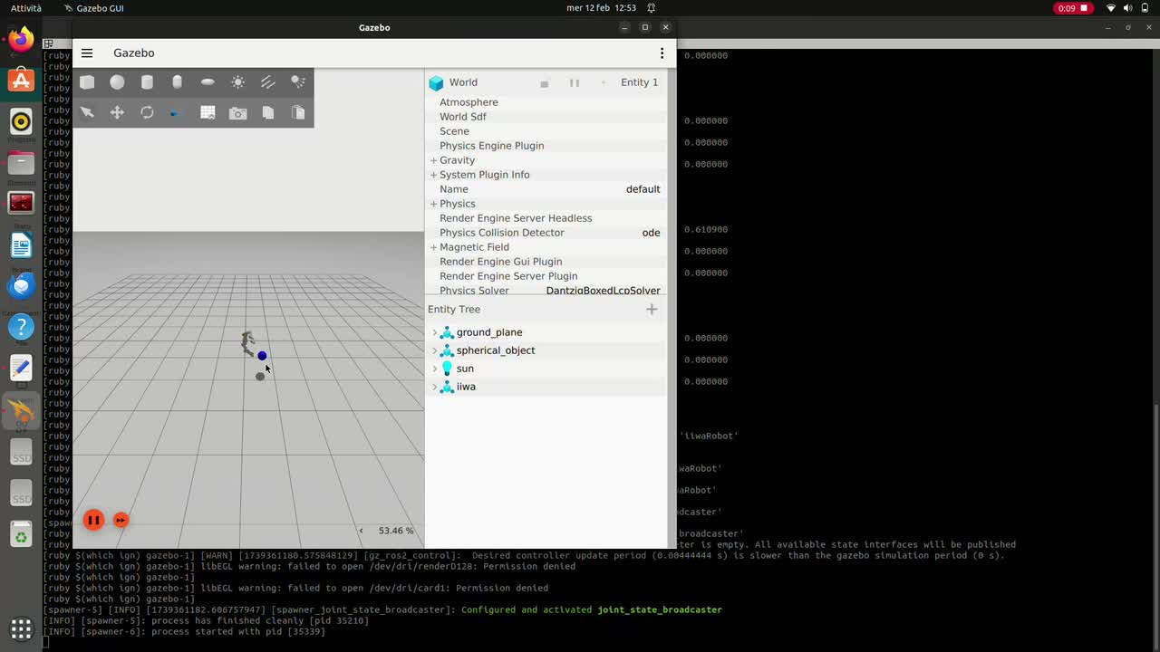

Slide 9
Homework 3
And then we have the last task for this first point. We have to write some code using the openCV functionatilies, this code has to subscribe to the topic on which the camera publishes the frames data and then the node needs to elaborate this data and try to detect some sort of element, in this case a blue element and we can find a way to use this information but also the element is a sphere so in 2D is similar to a circle, and we can use this information too as well. Here I show the code of the ros2_opencv_node and then I’ll show the results with a video.

Slide 10
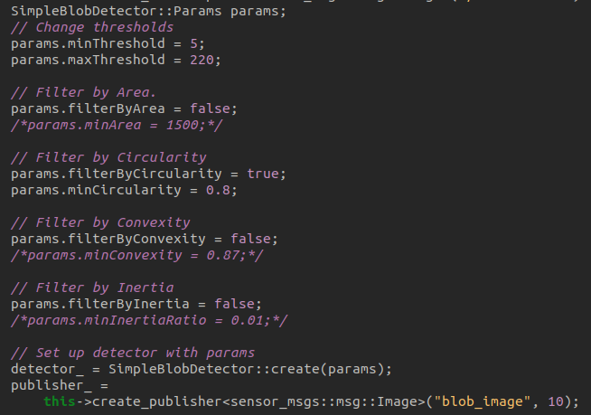
Homework 3
The first thing that I’ve done was to create a subscription to the camera topic so that the blob detector can see what the camera sees:
Then I declare the SimpleBlobDetector (it detects this so classe blobs) and I set and modify some useful parameters. Like the Threshold for the color palette but it isn’t so necessary, more useful is the filter by circulrity, so I set it (not like 1 so a perfect circle but some less, so that the little distortion of the camera does not affect the detection.

Slide 11
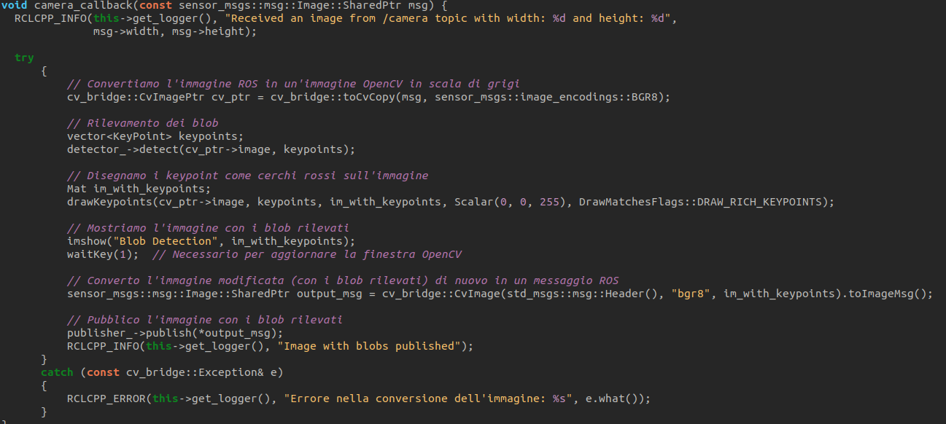
Homework 3
I’ve also implemented a publisher to publish the relevated image, if the object is detected it appears surrounded by a red circle. How I done this is shown below:

Slide 12
Homework 3
After all this slides and words, we only need a video that shows the detection of our proces and how we can understand that it works! And it’s shown in the next slide:

Slide 13
